Slide 1
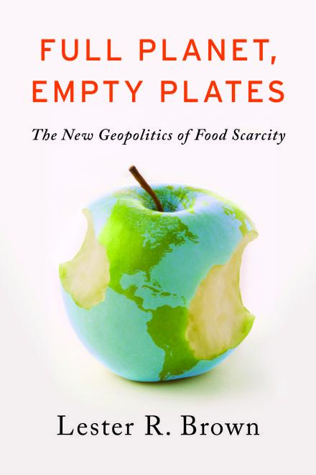

Full Planet,
Empty Plates:
The New Geopolitics of
Food Scarcity
An overview presentation for
A book by
Lester R. Brown

Slide 2
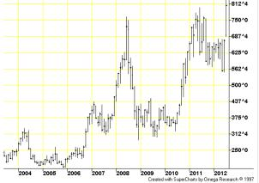
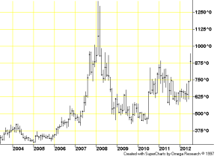
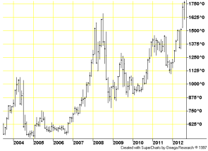
An Era of Rising Food Prices
2007-08: Grain and soybean prices more than doubled, leading to food riots and unrest in some 60 countries
Prices eased somewhat with global recession
2010-11: Another price spike helped fuel the Arab Spring
2012: Prices again approaching or setting records
Corn Futures Prices
Wheat Futures Prices
Soybean Futures Prices
Source: CME Group

Slide 3
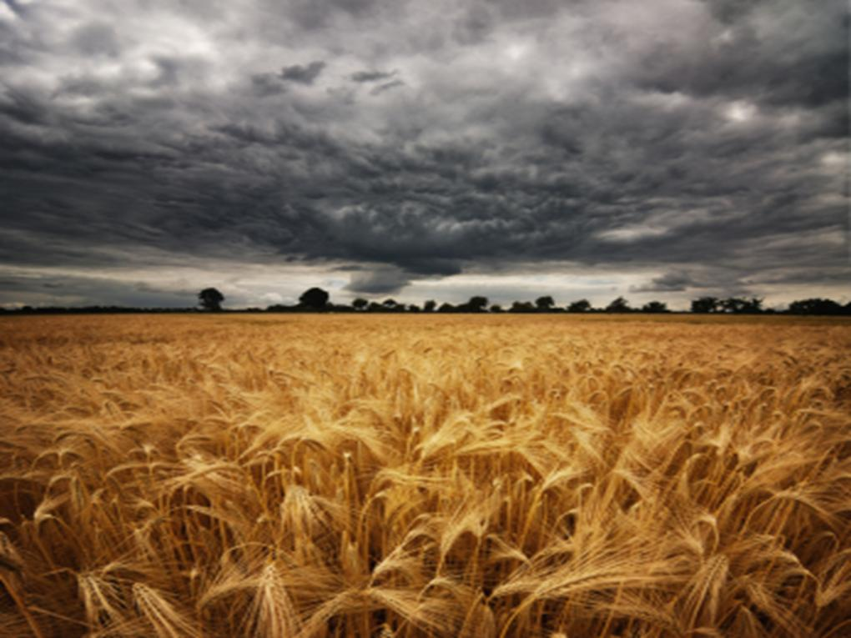
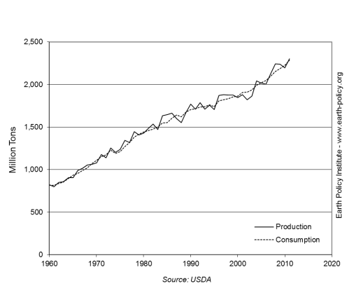
Precarious Global Food Situation
Dangerously small margin between grain consumption and grain production
Now we face long-term trends that:
  increase food demand
  limit food production
World Grain Production and Consumption, 1960-2011
We are only one poor harvest away from chaos in world grain markets.
Photo Credit: iStockPhoto / Tobias Helbig
Notes:
3

Slide 4
Demand Growing, Supply Strained
Demand Side
Supply Side
Growing population
People moving up the food chain
Biofuels turning food into fuel
Eroding soils
Depleting aquifers
Plateauing grain yields
Rising temperature
Photo Credit: iStockPhoto / Tobias Helbig

Slide 5
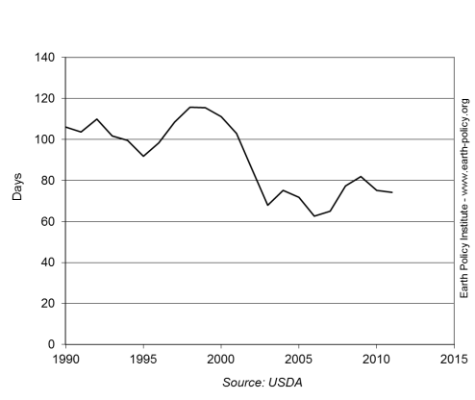
From Surplus to Scarcity
In the past, world had two safety cushions in case of harvest shortfall:
  idled U.S. cropland
  large stocks of grain
Now, we have lost those two safety cushions
  U.S. abandoned cropland set aside programs
  grain stocks have fallen dangerously low
World Grain Stocks as Days of Consumption, 1990-2012
Photo Credit: iStockPhoto / Tobias Helbig

Slide 6

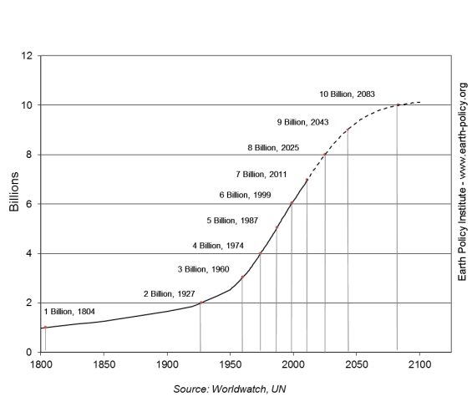
Population Pressures
7 billion people on the planet
Each year, nearly 80 million people added
Some 215 million women who want to plan their families lack access to family planning services
Large families trap people in poverty
World Population, 1800-2010, with Projection to 2100
We are fast outgrowing the earth’s capacity to sustain our increasing numbers.
Photo Credit: Yann Arthus-Bertrand

Slide 7
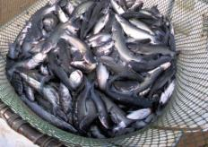

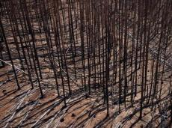
System Overload
Overfishing: 80% of oceanic fisheries are being fished at or beyond their sustainable yield
Overgrazing: The global grazing livestock population grew by 1.2 billion animals since 1960
Overcutting: The world’s forests lose a net 5.6 million hectares—an area the size of Costa Rica—each year
Overplowing: In parts of Africa, Asia, and the Middle East, productive cropland is turning into wasteland
Overpumping: Half the world’s population lives in countries that are extracting groundwater from aquifers faster than it is replenished
Photo Credit: USDA/ Stephen Ausmus; Yann Arthus-Bertrand

Slide 8
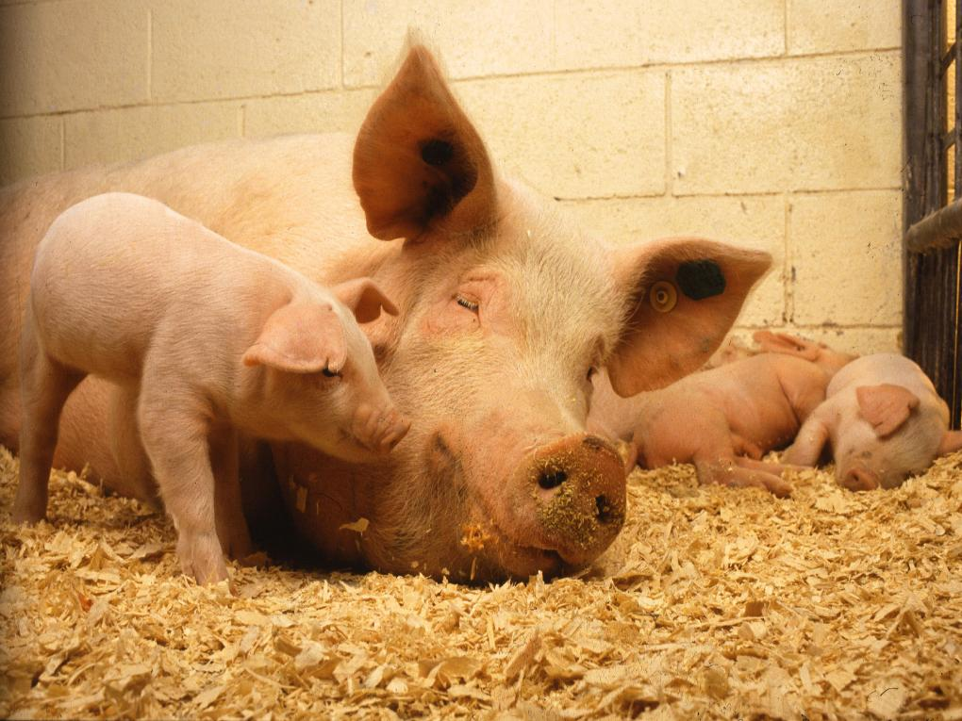
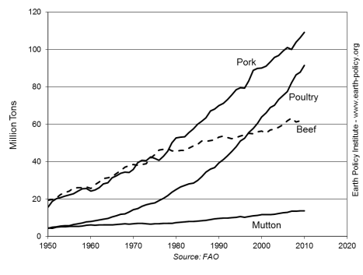
More Meat, More Feed
World meat demand grew fivefold since 1950
As incomes rise, some 3 billion people in the developing world desire to eat more meat, milk, and eggs
This requires more grain and soybeans for animal feed
World Meat Production by Type,
1950-2010
Photo Credit: USDA / Keith Weller

Slide 9
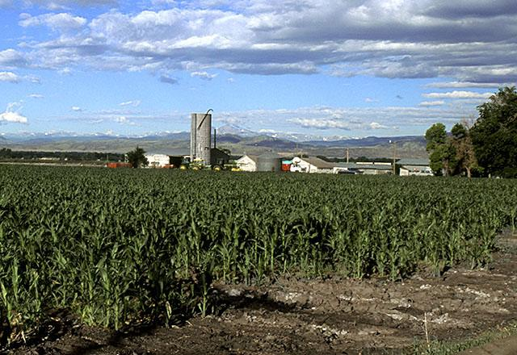
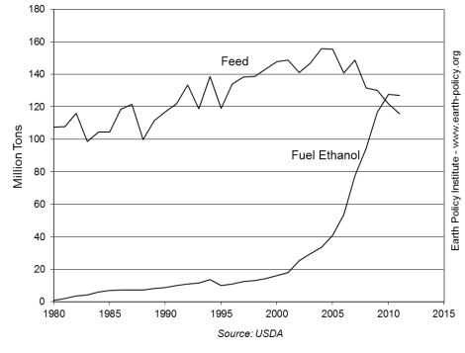
Feeding Cars Instead of People
U.S. corn is largest crop of any grain worldwide, critical to world supplies
Close to 1/3 of U.S. grain now going to ethanol
Grain used to fuel U.S. cars in 2011 could otherwise have fed 400 million people
U.S. ethanol euphoria beginning in 2005 helped raise food prices worldwide
Corn Use for Feed and Fuel Ethanol
in the United States, 1980-2011
The grain needed to fill an SUV’s 25-gallon tank with ethanol once could feed one person for a year.
Photo Credit: USDA / Scott Bauer

Slide 10
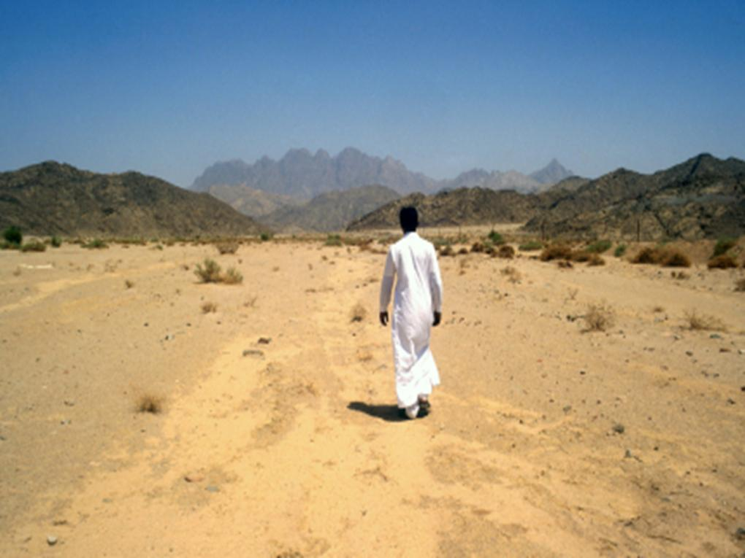
Worsening Soil Erosion
Overplowing, overgrazing, and deforestation make soil vulnerable to wind and water erosion
Roughly 1/3 of the world’s cropland is now losing topsoil faster than it can be re-formed
Topsoil loss reduces productivity, eventually leading farmers and herders to abandon their land
Countries such as Lesotho, Haiti, Mongolia, and North Korea are losing the ability to feed themselves
Photo Credit: iStockPhoto / Steven Allan
Notes:
10

Slide 11
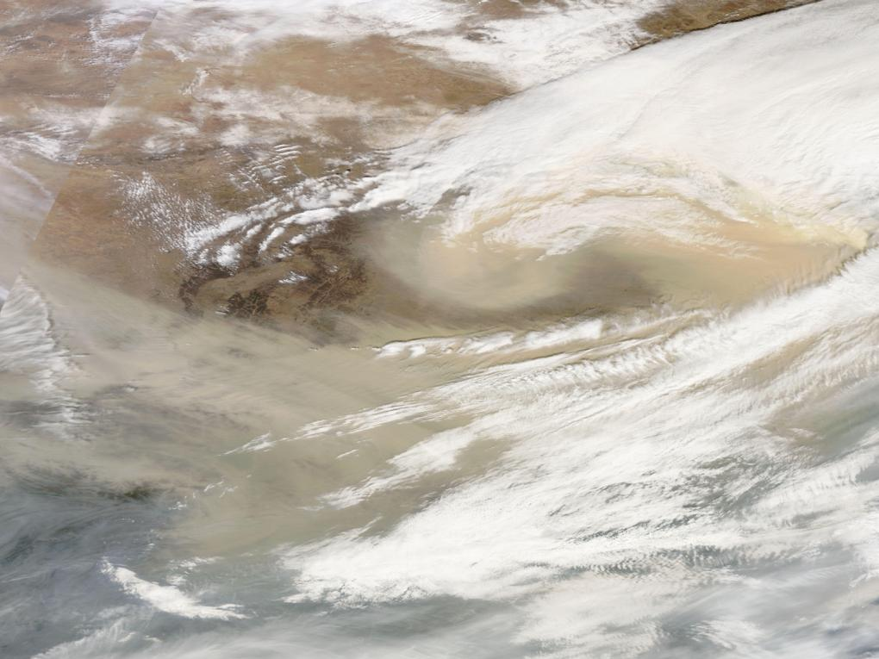
Dust Bowls Today
  Now overgrazing in northwestern China and western Mongolia is leading to the merging of deserts and the formation of dust storms that sweep across the continent, sometimes even as far as North America
  Population and livestock pressure in the African Sahel has destroyed soils; dust storms carrying 2–3 billion tons of soil leave Africa each year
These two newer dust bowls dwarf anything the world has seen before. We have yet to see their full effects.
Photo Credit: NASA Earth Observatory

Slide 12
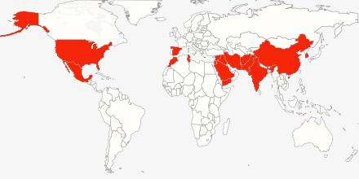
Coming Water Shortages
18 countries, 3.6 billion people
Source: EPI
Overpumping produces food bubbles that burst when water supplies dry up
175 million people in India and 130 million people in China eat grain produced by overpumping
In the Arab Middle East, a collision between population growth and water supply is reducing regional grain harvests

Slide 13
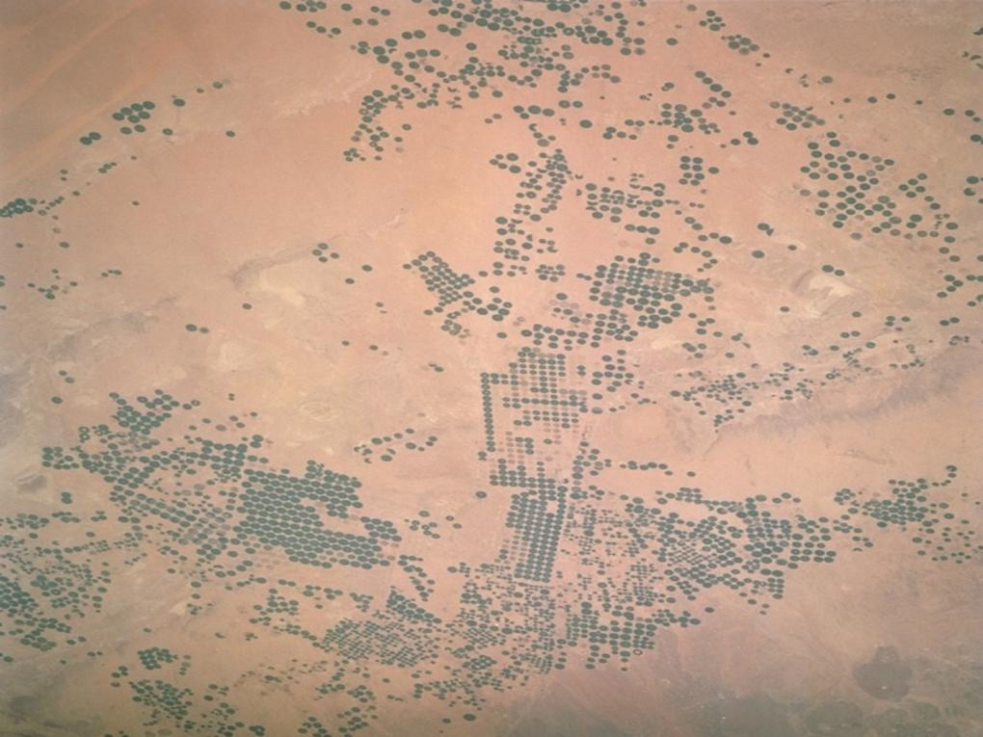
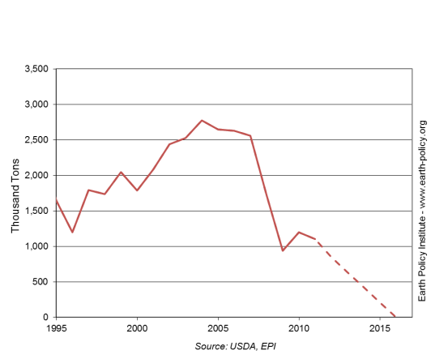
Saudi Arabia’s Bursting Bubble
Saudi Arabia became self-sufficient in wheat by tapping its non-replenishable aquifer to irrigate the desert
In early 2008, the government announced the aquifer was largely depleted
The population of nearly 30 million will be entirely dependent on imported grain by 2016
Wheat Production in Saudi Arabia, 1995-2011, with Projection to 2016
Saudi Arabia is the first country to publicly project how aquifer depletion will shrink its grain harvest.
Photo Credit: NASA

Slide 14
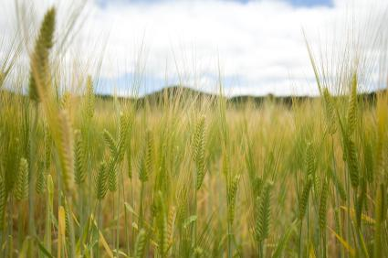
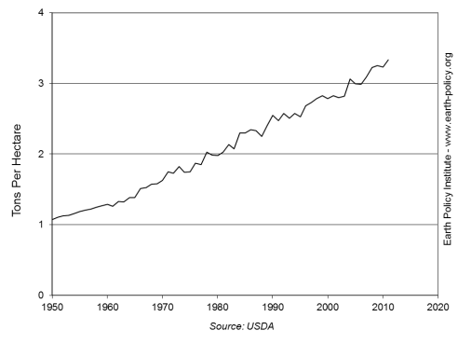
Growth in Grain Yields Slowing
World average grain yield has tripled since 1950
But the pace of growth is slowing
  1950-1990: It grew
  2.2% per year
  1990-2011: It grew
  1.3% per year
World Average Grain Yield, 1950-2011
In some of the more agriculturally advanced countries, the increase in grain yields has come to an end.
Photo Credit: iStockPhoto / Simon Oxley

Slide 15
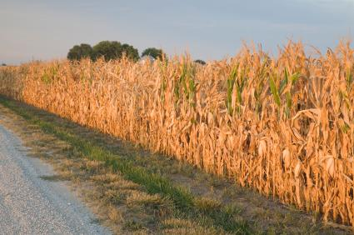
Where Else Will Grain Yields Stall?
Wheat yields in France, Germany, and the United Kingdom have not increased in more than a decade
Japan’s rice yields have plateaued; China’s may be leveling off as well
With rising temperatures, farmers everywhere face new climate constraints even as they approach biological limits
Thus far, rice or wheat yields have plateaued only in medium-sized countries. What happens when grain yields plateau in some of the larger ones?
Photo Credit: iStockPhoto / Dave Hughes

Slide 16
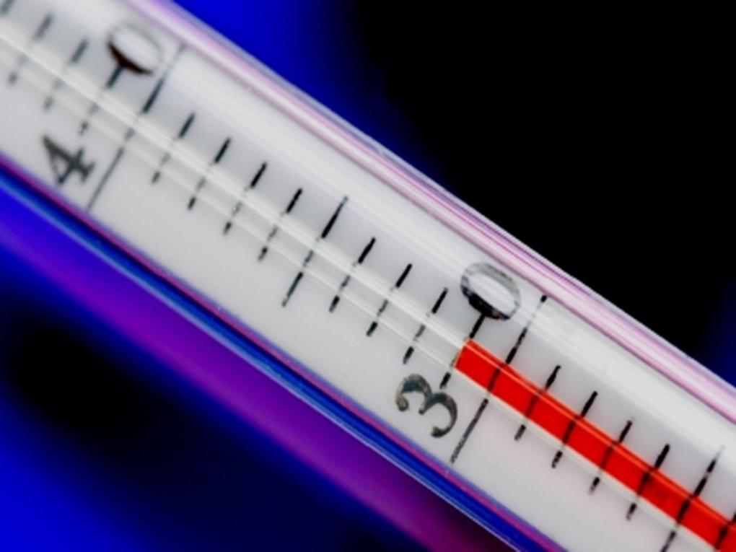
Higher Temperatures, Lower Yields
The massive burning of fossil fuels is increasing the level of carbon dioxide (CO₂) in the atmosphere, raising the earth’s temperature and disrupting climate
The Intergovernmental Panel on Climate Change projects earth’s average temperature will rise up to 6.4°C (11.5°F) during this century
Current trajectory is already outpacing projections
For every 1°C rise in temperature above the optimum during the growing season, yields of wheat, rice, and corn can be expected to drop 10%
Photo Credit: iStockPhoto / dra_schwartz
Notes:
16

Slide 17
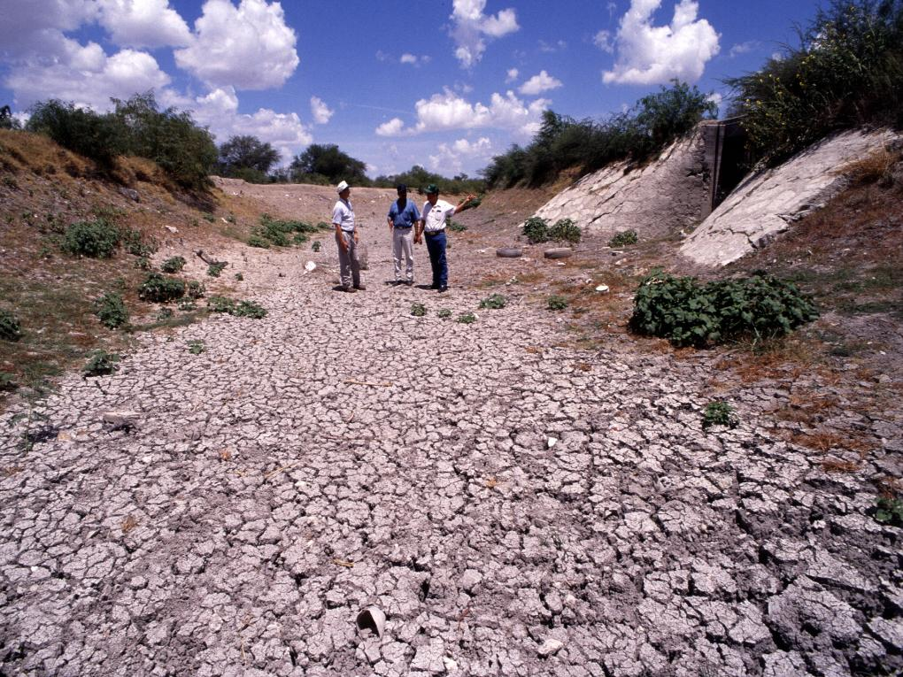
No More “Normal”
In the past, extreme weather events were anomalies and farmers could expect a return to normal conditions by the next harvest
But with rising temperatures and changing climate, there is no normal to return to
The 11,000 year period of relative climate stability in which agriculture developed is over
Increasing world grain stocks to ~110 days of consumption is one way to create a buffer against extreme weather
With each passing year, the agricultural system is becoming more out of sync with the climate system.
Photo Credit: USDA/Jack Dykinga

Slide 18
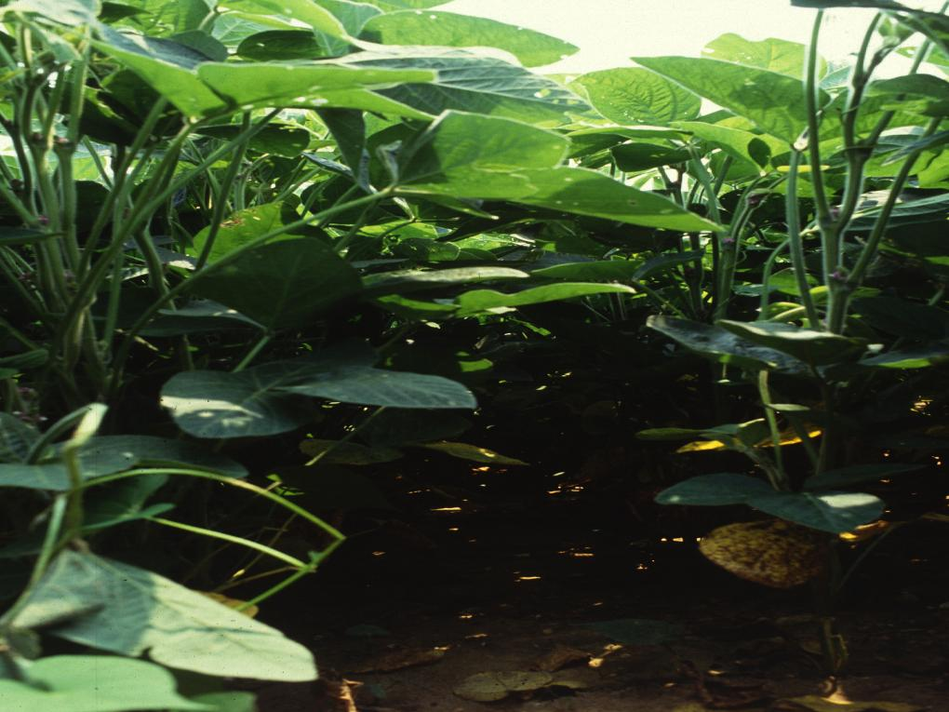
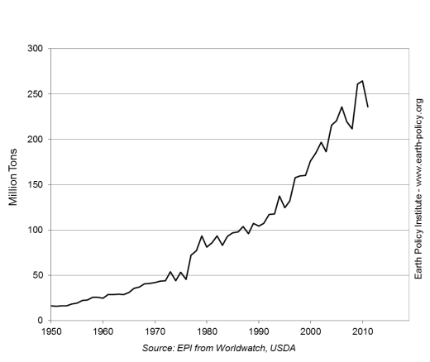
Soybeans Rise to Prominence
Soybeans originated in China 3,000 years ago
Since 1930, soybean meal has been mixed into livestock feed as a source of high-quality protein
Today, the United States, Brazil, and Argentina combined account for over four fifths of the total world production of nearly 250 million tons
World Soybean Production, 1950-2011
Photo Credit: USDA/ Scott Bauer

Slide 19
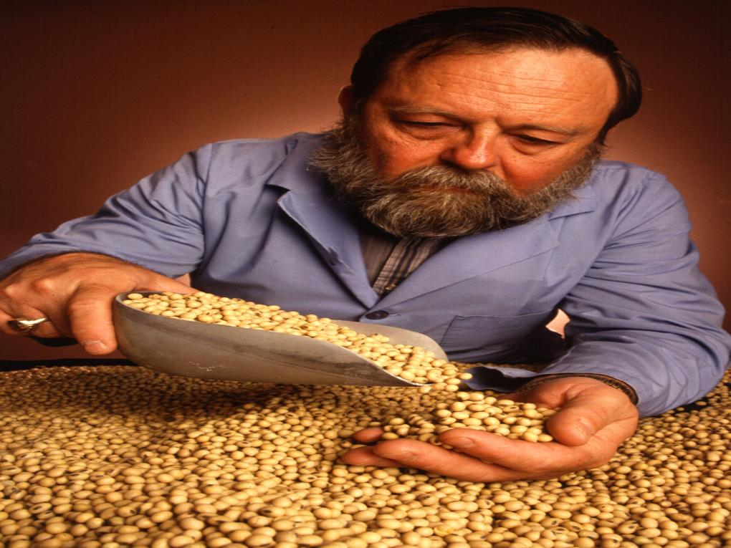
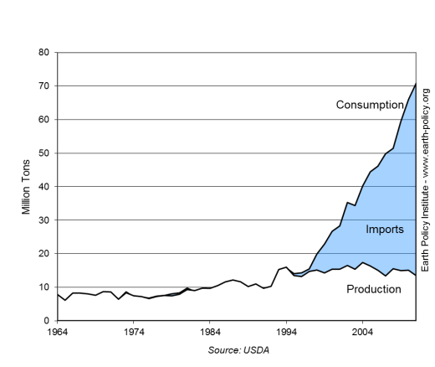
China Dominates Demand
In 2008, China surpassed the United States as the leading soybean consumer
500 million pigs – half the world total – live in China, eating soybean meal mixed with grain
China currently imports 60% of all soybeans traded internationally
Soybean Production, Consumption, and Imports in China, 1964-2011
As China and other developing countries continue to move up the food chain, this demand will only increase.
Photo Credit: USDA/ Keith Weller

Slide 20
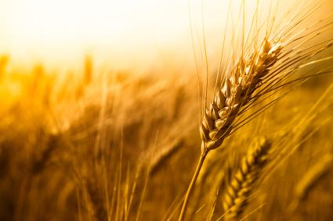
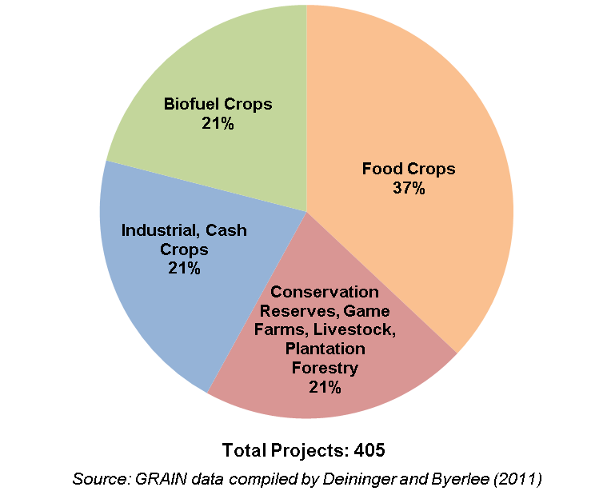
New Geopolitics of Food Scarcity
Doubling of grain, soybean prices in 2007-08 revealed a new geopolitics of food—every country for itself:
  Russia, Thailand, other grain exporting countries restricted or banned exports
  Some importers turned to buying or leasing tracts of land in other countries on which to grow food
  These land acquisitions, often called “land grabs,” multiplied quickly
Large-scale Land Acquisitions by Project Type, October 2008 – August 2009
Photo Credit: iStockPhoto / Pawel Gaul

Slide 21
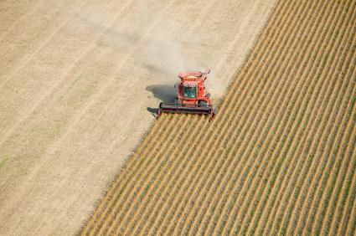
Ethiopia as Microcosm
Farmers, indigenous people often find out about deals only as they are forced from their land
  By early 2012, more than 1 million Ethiopians forcibly relocated by their government
Informal land rights make it difficult for people to protest
Projects using highly-mechanized, industrial agriculture; few jobs for local people
Food produced most often shipped to investor’s home country, contributing nothing to the local food supply
Land grabs for agriculture are also necessarily water grabs
Photo Credit: iStockPhoto / BanksPhotos

Slide 22
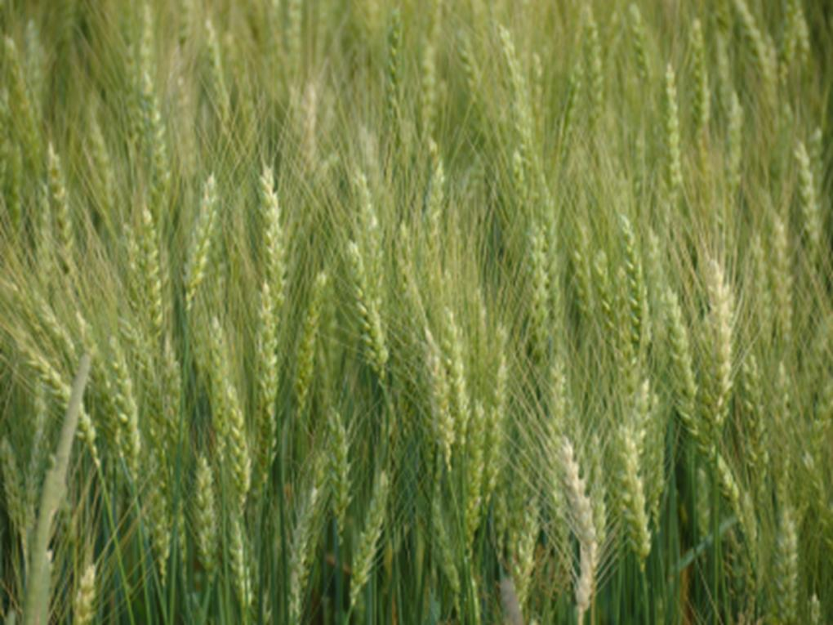
Toward a More Stable Food System
Demand Side
Supply Side
Stabilize population
Eradicate poverty
Reduce excessive meat consumption
Eliminate biofuels mandates
Conserve soil
Increase water productivity
Fill the yield gap
Stabilize climate
If we tackle both sides of the food equation, we can rebuild world grain stocks, improving food security.
Photo Credit: iStockPhoto / Niko Vujevic

Slide 23

Redefining Security
Historically, security has been defined mostly in military terms
But today climate volatility, emerging water shortages, spreading hunger, and failing states are the new threats to survival
Food security is not just in the hands of agricultural departments
The challenge is to reorder fiscal priorities to match these new dangers
Photo Credit: Yann Arthus-Bertrand

Slide 24
To learn more about the global food situation…
read Full Planet, Empty
Plates: The New Geopolitics
of Food Scarcity by
Lester R. Brown. The book and supporting data sets are available at
www.earth-policy.org
Notes:
24

